Slide 1

Artificial Intelligence in Finance Genetic algorithm with R
Hadi Movaghari
2022-2023

Slide 2
Outline
Section 1: Preliminaries
Section 2: One-dimensional optimization problems
Section 3: Tow-dimensional optimization problems
Artificial Intelligence in Finance: GA with R
University of Glasgow
2022-2023

Slide 3
Section 1: Preliminaries

Slide 4

Bibliography
We are using the GA package:
Scrucca, L. (2013). GA: A package for genetic algorithms in R. Journal of Statistical Software, 53, 1-37.
Scrucca, L. (2017). On some extensions to GA package: hybrid optimisation, parallelisation and islands evolution. The R Journal, 9(1), 187-206.
A textbook for genetic algorithm in R (Chapter 5)
Cortez, P., & Cortez. (2021). Modern optimization with R. Second Edition, New York: Springer.
Another useful textbook:
Haupt, R. L., & Haupt, S. E. (2004). Practical genetic algorithms. Second Edition, John Wiley & Sons.
Available online
Artificial Intelligence in Finance: GA with R
University of Glasgow
2022-2023

Slide 5
Genetic algorithm
Genetic Algorithms (GAs) are (Scrucca, 2013):
Adaptive search algorithms that belong to the larger part of evolutionary algorithms.
They are commonly used to generate high-quality solutions for optimization problems.
Artificial Intelligence in Finance: GA with R
University of Glasgow
2022-2023

Slide 6
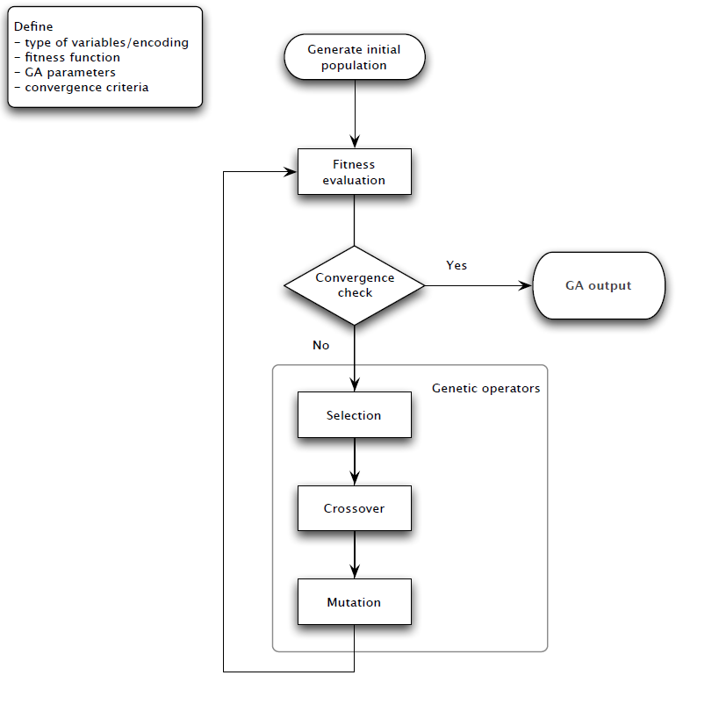
Genetic algorithm (Cont’d)
The process of GA
Source: Scrucca (2013)
Artificial Intelligence in Finance: GA with R
University of Glasgow
2022-2023

Slide 7
Genetic algorithm (Cont’d)
Some of the advantages of a GA include that it (Haupt and Haupt, 2004):
Optimizes with continuous or discrete variables,
Doesn’t require derivative information,
Simultaneously searches from a wide sampling of the cost surface,
Deals with a large number of variables,
Is well suited for parallel computers,
Optimizes variables with extremely complex cost surfaces (they can jump out of a local minimum),
Provides a list of optimum variables, not just a single solution,
May encode the variables so that the optimization is done with the encoded variables, and
Works with numerically generated data, experimental data, or analytical functions.
Artificial Intelligence in Finance: GA with R
University of Glasgow
2022-2023

Slide 8
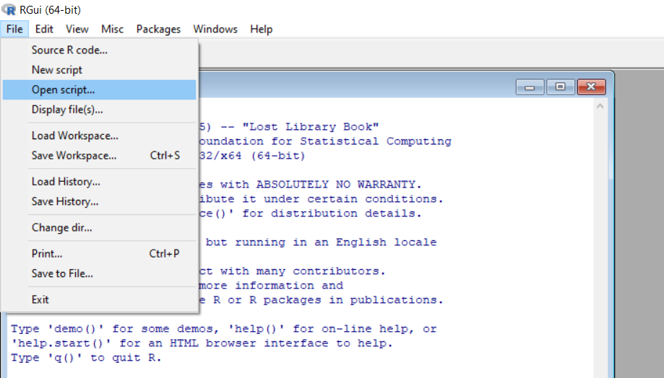
Open your script file!
Download files (script, data, PowerPoint) from Moodle or https://github.com/hadigilan/AIFinance_genetic_algorithm.git
From File -> Open script find your file and then open
Artificial Intelligence in Finance: GA with R
University of Glasgow
2022-2023

Slide 9
Writing your own function in R
General structure of a user-defined function in R has a following form:
function name<- function (parameter1, parameter2, …) {
body of function
return statement
}
Artificial Intelligence in Finance: GA with R
University of Glasgow
2022-2023

Slide 10
Part 6: The package
There are different R packages that implement genetic algorithms.
We use he package GA. Other packages include genalg, Rmalschains, rgenoud, among others.
To install the package and load it, run the following codes:
install.packages(“GA")
library(GA)
You can download the manual of the package from https://cran.r-project.org/web/packages/GA/GA.pdf
You can cite the package in your publication
citation("GA")
Artificial Intelligence in Finance: GA with R
University of Glasgow
2022-2023

Slide 11
Part 6: The package (Cont’d)
The main function in the GA package is ga with the following main arguments:
type
The nature of decision variables
fitness
The name of objective function
A vector of length equal to the decision variables providing the minimum of the search space
upper
lower
maxiter
A vector of length equal to the decision variables providing the maximum of the search space
nBits
The maximum number of iterations before the GA search is halted
A value specifying the number of bits to be used in binary optimizations
Artificial Intelligence in Finance: GA with R
University of Glasgow
2022-2023

Slide 12
Part 6: The package (Cont’d)
To run the ga function, we need at least:
For continuous search: arguments type, fitness, lower and upper.
For binary search: arguments type, fitness, nBits.
In addition to final solution, ga provides several other outputs, e.g., the value of function in each iteration, etc.
Artificial Intelligence in Finance: GA with R
University of Glasgow
2022-2023

Slide 13
Part 6: The package (Cont’d)
selection
operator
Linear-rank
Nonlinear-rank
Proportional
Tournament
Goldberg's sigma truncation scaling
linear scaling
Available functions for the selection operator in the ga function
a function which generates a new population from the current population
The default is linear-rank selection
Artificial Intelligence in Finance: GA with R
University of Glasgow
2022-2023

Slide 14
Part 6: The package (Cont’d)
crossover operator
Single-point
Uniform
Whole arithmetic
Local arithmetic
Cycle
Blend
Partially matched
Order
Position-based
Available functions for the crossover operator in the ga function:
a function to combine the genetic information from their parents
The default is single-point crossover
Artificial Intelligence in Finance: GA with R
University of Glasgow
2022-2023

Slide 15
Part 6: The package (Cont’d)
mutation operator
Uniform random
Nonuniform random
Simple inversion
Insertion
Displacement
swap
Scramble
Available functions for the mutation operator in the ga function:
a function which randomly alters the values of some genes in a parent chromosome
The default is uniform random mutation
Artificial Intelligence in Finance: GA with R
University of Glasgow
2022-2023

Slide 16
Section 1: One-dimensional optimization problem

Slide 17
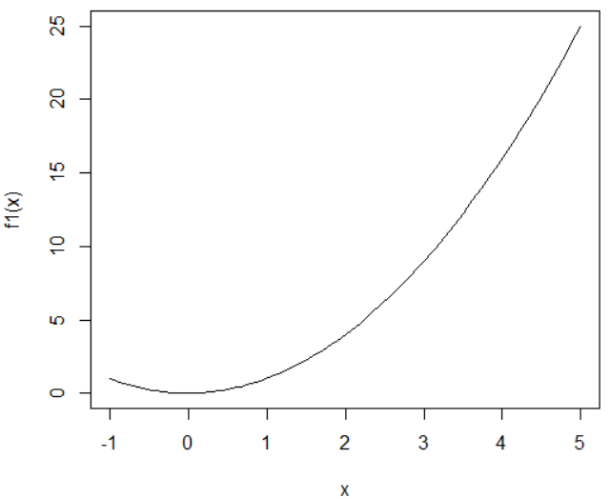

Example 1: $x^{2}$ (maximization)
f1 <- function(x) x^2
left <- -1
right <- 5
curve(f1, from=left , to=right )
curve is a built-in function to draw a curve corresponding to a function over the interval [from, to]
Artificial Intelligence in Finance: GA with R
University of Glasgow
2022-2023

Slide 18
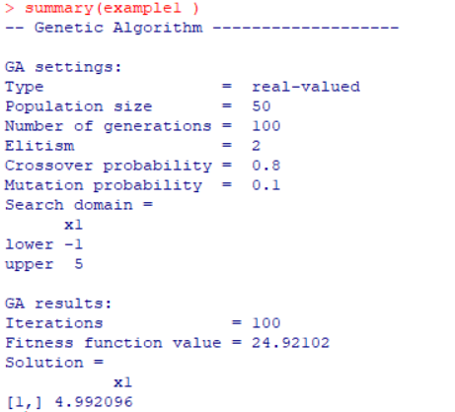

Example 1: $x^{2}$ (Cont’d)
example1 <- ga(type = "real-valued", fitness = f1,
lower = left , upper = right, maxiter = 100)
summary(example1 )
Since we are optimizing on the real values, we set the argument type to “real-valued”
lower and upper arguments together identify search space
summary is a generic function to print the results of ga
Artificial Intelligence in Finance: GA with R
University of Glasgow
2022-2023

Slide 19
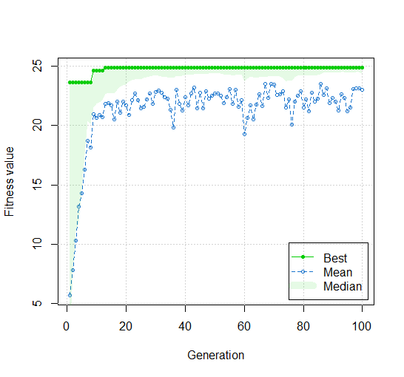
Example 1 (Cont’d)
To see the process of optimization over iterations:
plot(example1)
example1 is the name of the object which contains the results of the ga function
Artificial Intelligence in Finance: GA with R
University of Glasgow
2022-2023

Slide 20

Example 2: $x^{2}$ (minimization)
By default ga finds the maximum. To find minimum, use the negative of the desired function.
To extract the final solution of the ga use the following code with @ operator :
name of the ga function@solution
f2 <- function(x) -f1(x)
left <- -1
right <- 5
example2 <- ga(type = "real-valued", fitness = f2, lower = left , upper = right, maxiter = 100 )
summary(example2)
example2@solution
Artificial Intelligence in Finance: GA with R
University of Glasgow
2022-2023

Slide 21
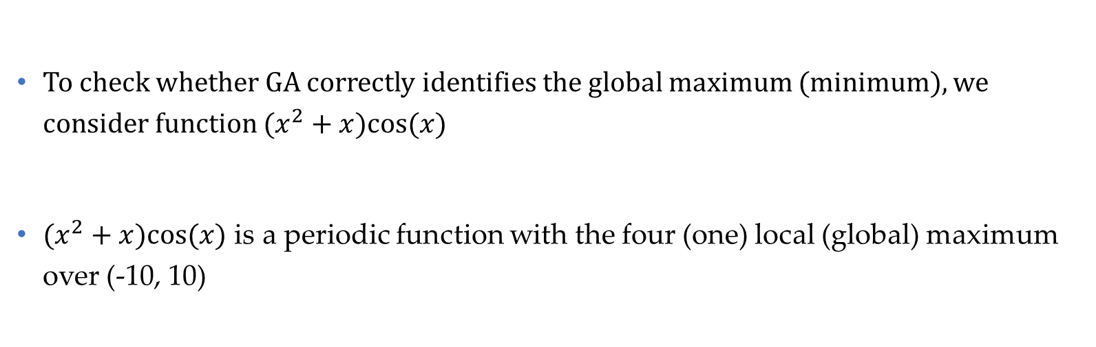
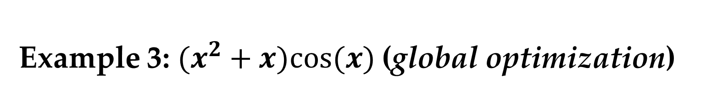
Example 3: $(x^{2}+x)cos⁡(x)$(global optimization)
To check whether GA correctly identifies the global maximum (minimum), we consider function $(x^{2}+x)cos⁡(x)$
$(x^{2}+x)cos⁡(x)$ is a periodic function with the four (one) local (global) maximum over (-10, 10)
Artificial Intelligence in Finance: GA with R
University of Glasgow
2022-2023

Slide 22
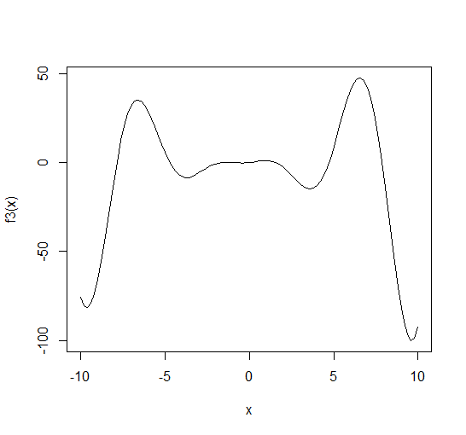

Example 3: $(x^{2}+x)cos⁡(x)$(Cont’d)
f3 <- function(x) (x^2 + x) * cos(x)
left <- -10
right <- 10
curve(f3, from=left , to=right )
Artificial Intelligence in Finance: GA with R
University of Glasgow
2022-2023

Slide 23
Example 3: $(x^{2}+x)cos⁡(x)$(Cont’d)
example3 <- ga(type = "real-valued", fitness = f3, lower = left, upper = right, maxiter = 100 )
example3@solution
curve(f3, from=left , to=right )
points(x=example3@solution, y=example3@fitnessValue, pch=16, col="red")
Last lines is used to show the location of obtained maximum value by ga on the curve
points is a built-in function to plot point(s) identified by x and y. pch=16 is an argument to draw a filled circle.
To extract the value of objective function at the solution of ga use the following code with @ operator :
name of the ga function@fitnessValue
Artificial Intelligence in Finance: GA with R
University of Glasgow
2022-2023

Slide 24
Section 2: Two-dimensional optimization problem

Slide 25
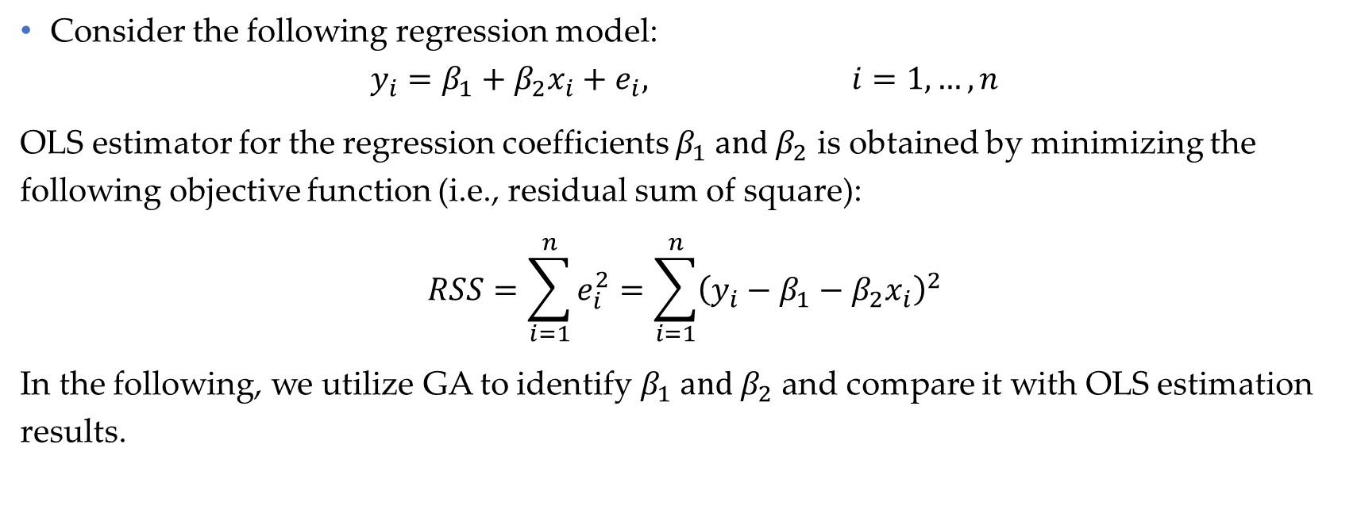
Example 4: OLS regression
Consider the following regression model:
$$y_{i}=β_{1}+β_{2}x_{i}+e_{i}, i=1,…,n$$
OLS estimator for the regression coefficients $β_{1} and β_{2}$ is obtained by minimizing the following objective function (i.e., residual sum of square):
$$RSS=\sum_{i=1}^{n}{e_{i}^{2}}=\sum_{i=1}^{n}{{\left(y_{i}−β_{1}−β_{2}x_{i}\right)}^{2}}$$
In the following, we utilize GA to identify $β_{1} and β_{2}$ and compare it with OLS estimation results.
Artificial Intelligence in Finance: GA with R
University of Glasgow
2022-2023

Slide 26
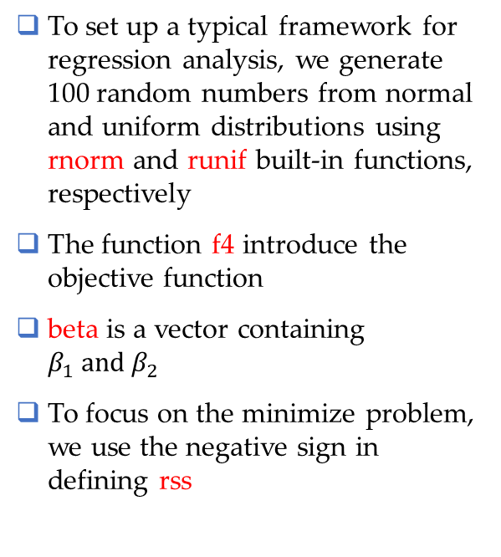
Example 4 (Cont’d)
y<- rnorm(100)
x<- runif(100)
data4<- data.frame(y, x)
f4<- function(beta, x, y){
y.hat <- beta[1] + (beta[2]*x);
rss<- -sum( (y-y.hat)^2) ;
return(rss);
}
To set up a typical framework for regression analysis, we generate 100 random numbers from normal and uniform distributions using rnorm and runif built-in functions, respectively
The function f4 introduce the objective function
beta is a vector containing $β_{1} and β_{2}$
To focus on the minimize problem, we use the negative sign in defining rss
Artificial Intelligence in Finance: GA with R
University of Glasgow
2022-2023

Slide 27
Example 4 (Cont’d)
In two-dimensional (or more) optimization problems, additional arguments of the objective function can be introduced in the ga function as arguments
We can choose arbitrary names for parameters using the names argument, which will be shown in the output
left <- c(-10, -10)
right <- c(10, 10)
example4 <- ga(type = "real-valued", fitness = f4, x=data4$x, y=data4$y, lower = left , upper = right, maxiter = 100, names=c('beta1', 'beta2') )
Artificial Intelligence in Finance: GA with R
University of Glasgow
2022-2023

Slide 28
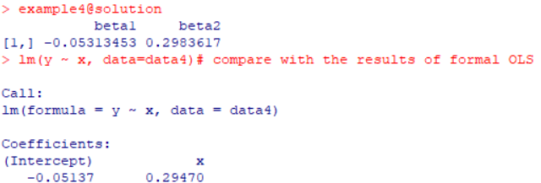
Example 4 (Cont’d)
example4@solution
lm(y ~ x, data=data4)
To compare the GA results against OLS estimation results, we use lm built-in function
Artificial Intelligence in Finance: GA with R
University of Glasgow
2022-2023

Slide 29
Contact
If you have any question regarding R programming and financial econometrics, or any suggestion to improve the teaching style, please feel free to contact me through:
Hadi.Movaghari@glasgow.ac.uk
Artificial Intelligence in Finance: GA with R
University of Glasgow
2022-2023

